Slide 1

The Foundations of
Entrepreneurship
Chapter1: Entrepreneurship
1

Slide 2
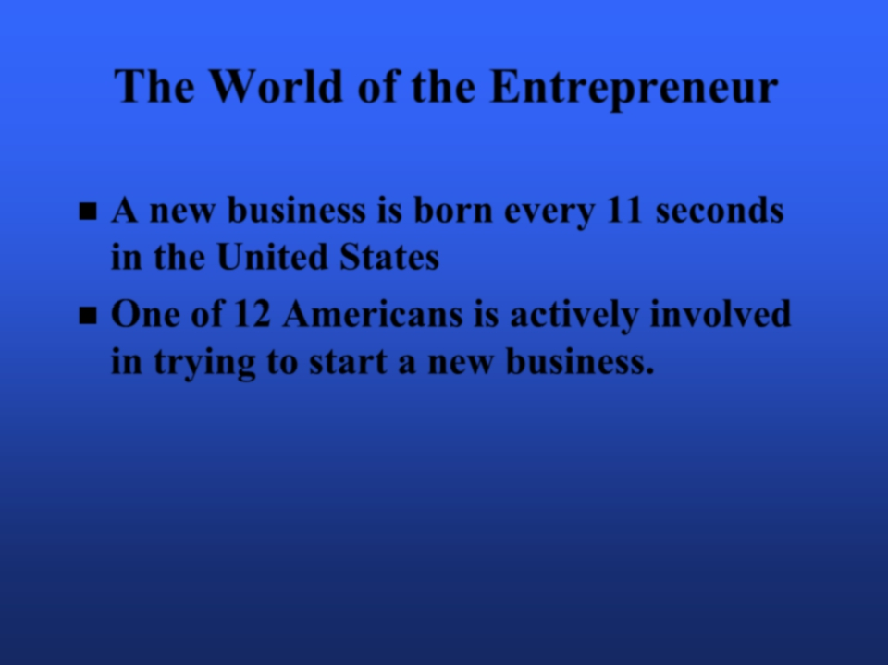

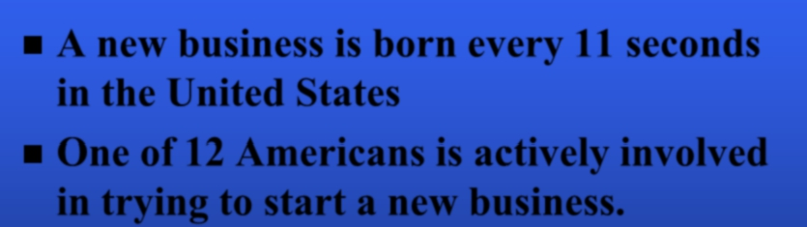
The World of the Entrepreneur
A new business is born every 11 seconds
■
in the United States
■ One of 12 Americans is actively involved
in trying to start a new business.
Chapter1: Entrepreneurship
2

Slide 3
What is an Entrepreneur?
One who creates a new business in the face
of risk and uncertainty for the purpose of
achieving profit and growth by identifying opportunities and assembling
the necessary resources to capitalize on
them.

Slide 4
What is Entrepreneurship ?
Entrepreneurship : The process of initiating a business venture, organizing the necessary resources, and assuming the risks and rewards

Slide 5
When most people describe entrepreneurs, they use adjectives such as bold, innovative, initiative taking, venturesome, and risk taking. They also tend to associate entrepreneurs with small businesses.

Slide 6
The three important themes in this definition are:
(1) the pursuit of opportunities
(2) innovation
(3) growth.
Entrepreneurs pursue opportunities to grow a business by changing ,revolutionizing , transforming or introducing new products or services.

Slide 7
Characteristics of Entrepreneurs
1- Desire for responsibility
2- Preference for moderate risk
3- Confidence in their ability to succeed
4- Desire for immediate feedback
5- High level of energy
6- Future orientation
7- Skilled at organizing
8- Value achievement over money
9- Self-confidence
10- Flexibility

Slide 8
The “Type E” Personality
Common Traits of Entrepreneurs:
Aggressively pursues goals; pushes self and others
Seeks autonomy, independence and freedom from boundaries
Sends consistent messages; very focused
Acts quickly, often without deliberating
Pursues simple, practical solutions
Willing to take risks; comfortable with uncertainty
Exhibits clear opinions and values; has high expectations
“just do it”
Positive, optimistic; communicates confidence

Slide 9
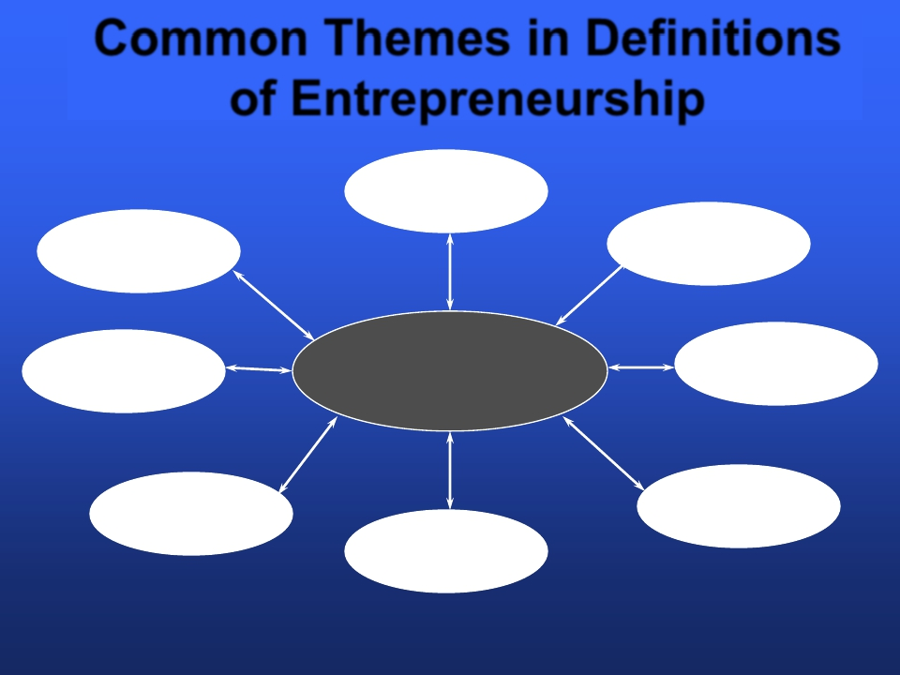





Common Themes in Definitions
of Entrepreneurship
Process
The
Uniqueness
Growth
Profit or
Nonprofit
Entrepreneur
Innovation
Organization
Creation
Defining
Entrepreneurship
Creating
Value
Chapter1: Entrepreneurship
7

Slide 10
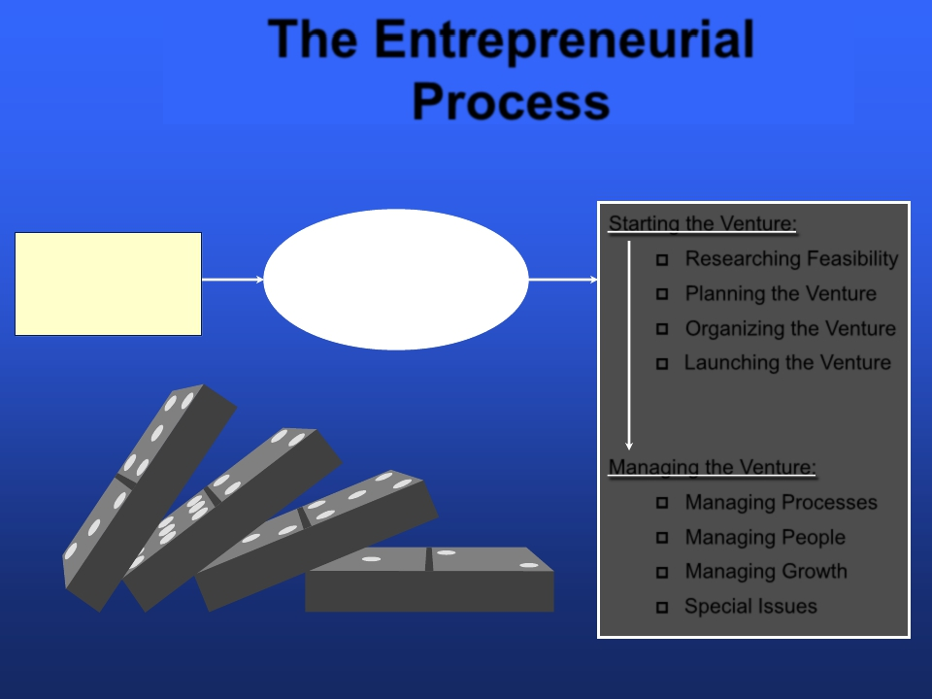

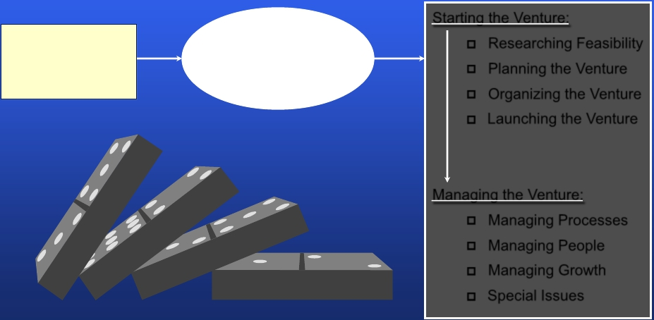
The Entrepreneurial
Process
Starting the Venture:
Exploring the
Entrepreneurial
Context
Identifying
Opportunities/Possible
Competitive Advantage
❐
❐
❐
❐
Researching Feasibility
Planning the Venture
Organizing the Venture
Launching the Venture
Managing the Venture:
Managing Processes
❐
Managing People
❐
Managing Growth
❐
Special Issues
❐
Chapter1: Entrepreneurship
8
Copyright 2002 Prentice Hall Publishing Company

Slide 11
What is the Entrepreneurial process?
What’s involved in the entrepreneurial process? Entrepreneurs must address four key steps as they start and manage their entrepreneurial ventures.
The first of these steps is exploring the entrepreneurial context. The context includes the realities of the new economy, society’s laws and regulations that compose the legal environment and the realities of the changing world of work.

Slide 12
It’s important to look at each of these aspects of the entrepreneurial context because they determine the “rules” of the game and what decisions and actions are likely to meet with success. Also, it’s through exploring the context that entrepreneurs confront that next critically important step in the entrepreneurial process – identifying opportunities and possible competitive advantages.

Slide 13
We know from our definition of entrepreneurship that the pursuit of opportunities is an important aspect.
Once entrepreneurs have explored the entrepreneurial context and identified opportunities and possible competitive advantages, they must look at the issues involved in actually bringing their venture to life.

Slide 14
Therefore, the next step in the entrepreneurial process is starting the venture. Included in this phase are researching the feasibility of the venture and planning, organizing and launching the venture.
Finally once the entrepreneurial venture is up and running, the last step in the process is managing the venture, which an entrepreneur does by managing processes, people, and growth.

Slide 15
Describing what entrepreneurs do isn’t an easy or simple task. No two entrepreneurs’ work activities are exactly alike. In a general sense, entrepreneurs are creating something new, something different. They’re searching for change, responding to it and exploiting it.

Slide 16
Like most entrepreneurs, Michael Dell, the founder of Dell Inc, searches for change, responds to it, and then exploits the opportunity. In China, for example, Dell specifically designed a new, low cost computer that enables large numbers of novices to get online. Pursuing the opportunity of a new market by offering an innovative product keeps Dell Inc on its successful path of growth.

Slide 17
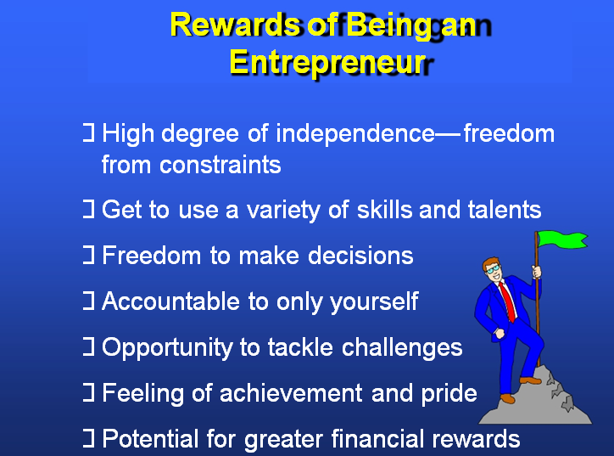

Slide 19


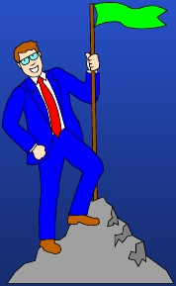
□ High degree of independence—freedom
from constraints
□ Get to use a variety of skills and talents
□ Freedom to make decisions
□ Accountable to only yourself
□ Opportunity to tackle challenges
□ Feeling of achievement and pride
□ Potential for greater financial rewards
Chapter1: Entrepreneurship
9

Slide 20


□Must be comfortable with change and
uncertainty
□Must make a bewildering number of
decisions
□May face tough economic choices
□Must be comfortable with taking risks
□Need many different skills and talents
□Must be comfortable with the potential for
failure
Chapter1: Entrepreneurship
10

Slide 21
the Cultural Diversity of Entrepreneurship
1- Young entrepreneurs
2- Women
3- Minority-owned enterprises
4- Part-time entrepreneurs
5- Home-based businesses
6- Family businesse (Owned and financially controlled by family members).
7- Corporate dropouts

Slide 22
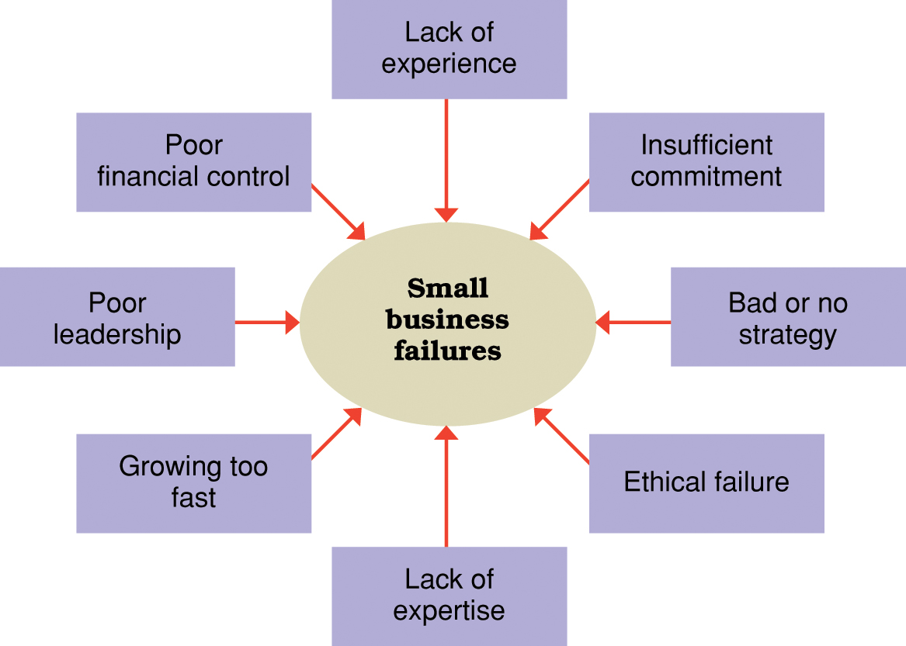
Reasons why many small businesses fail.

Slide 23

What is the difference between an entrepreneur and a small business owner?
There are distinct differences in the mindset and motivations of both entrepreneurs and small business owners

Slide 24
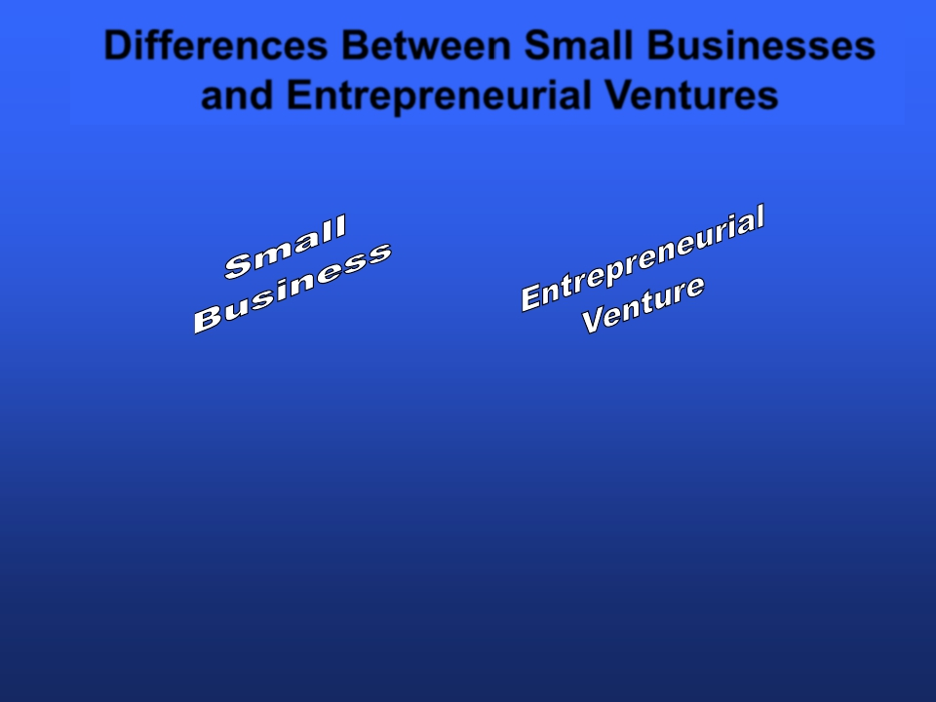

Differences Between Small Businesses
and Entrepreneurial Ventures
□ Independently owned,
operated, and financed
□ Less than 100 employees
□ Doesn’t emphasize new
or innovative practices
□ Little impact on industry
□ Innovative practices
□ Goals are profitability and growth
□ Seeks out new opportunities
□ Willingness to take risks
Chapter1: Entrepreneurship
14

Slide 25
Many people believe that entrepreneurial activities and small business are one and the same, but they are not. There are some key differences between the two. Entrepreneurs create entrepreneurial ventures – organizations that pursue opportunities, are characterized by innovative practices, and have growth and profitability as their primary goals.

Slide 26
A small business, on the other hand, is one that is independently owned, operated, and financed; doesn’t necessarily engage in any new or innovative practices; and usually has relatively little impact on its industry.

Slide 27
A small business isn’t necessarily entrepreneurial because it’s small. To be entrepreneurial means to be innovative and seek out new opportunities. Even though entrepreneurial ventures may start small, they pursue growth. Some new small firms may grow, but remain small business by choice or by default.

Slide 28

Benefits of Small Business Ownership
The opportunity to:
■ create your own destiny
■ make a difference
■ reach your full potential
■ reap unlimited profits
■ contribute to society and be recognized for
your efforts
■ do what you enjoy and have fun at it.
The opportunity to:
■ create your own destiny
■ make a difference
■ reach your full potential
■ reap unlimited profits
■ contribute to society and be recognized for
your efforts
■ do what you enjoy and have fun at i

Slide 29

Drawbacks of Small Business Ownership
Uncertainty of income
■ Risk of losing your entire investment
■ Long hours and hard work
■ Lower quality of life until the business gets
established
■ High levels of stress
■ Complete responsibility
■ Discouragement

Slide 30
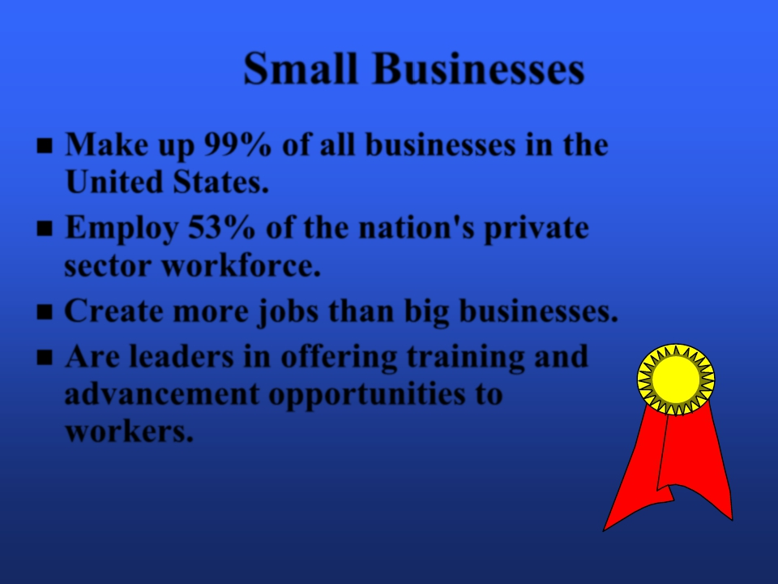

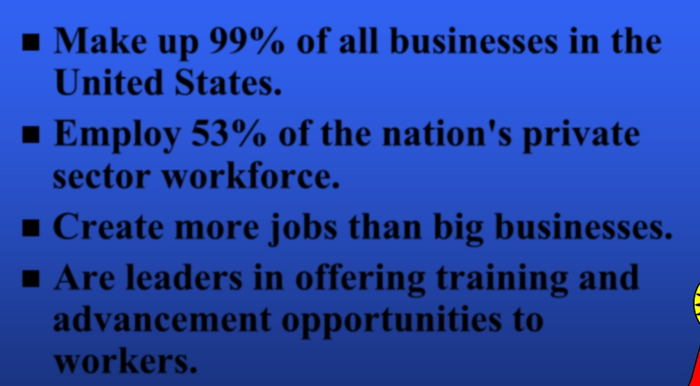
Small Businesses
Make up 99% of all businesses in the
■
United States.
■ Employ 53% of the nation's private
sector workforce.
■ Create more jobs than big businesses.
■ Are leaders in offering training and
advancement opportunities to
workers.
Chapter1: Entrepreneurship
17

Slide 31
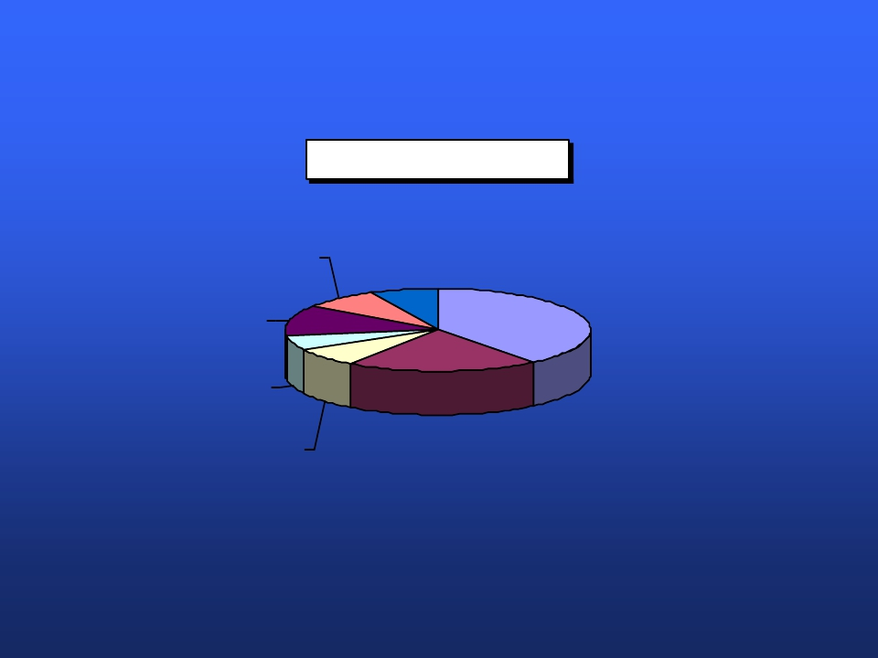
Small Business by Industry
Financial
8.0%
Other
7.3%
Services
39.2%
Construction
11.8%
Manufacturing
5.8%
Wholesale
7.4%
Retail
20.5%

Slide 32
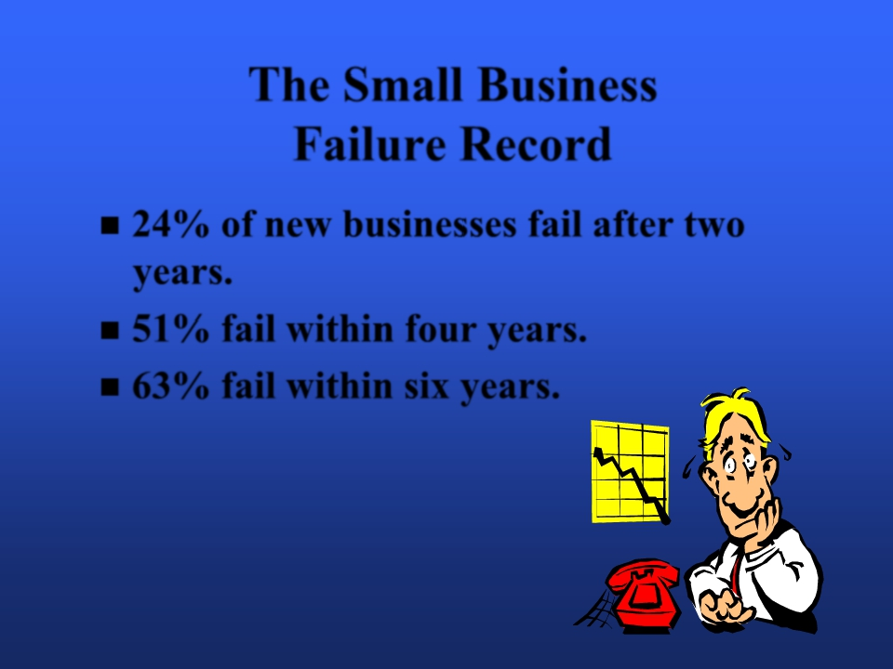

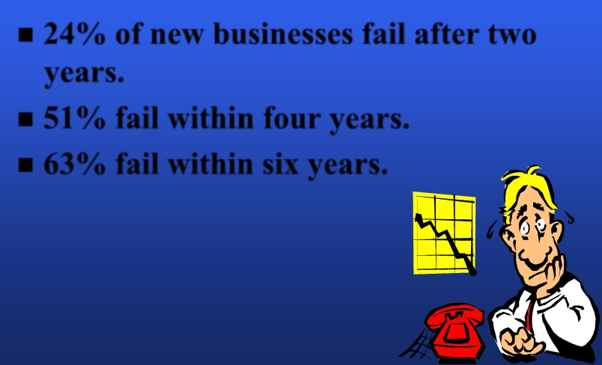
The Small Business
Failure Record
24% of new businesses fail after two
■
years.
■ 51% fail within four years.
■ 63% fail within six years.
Chapter1: Entrepreneurship
2

Slide 33
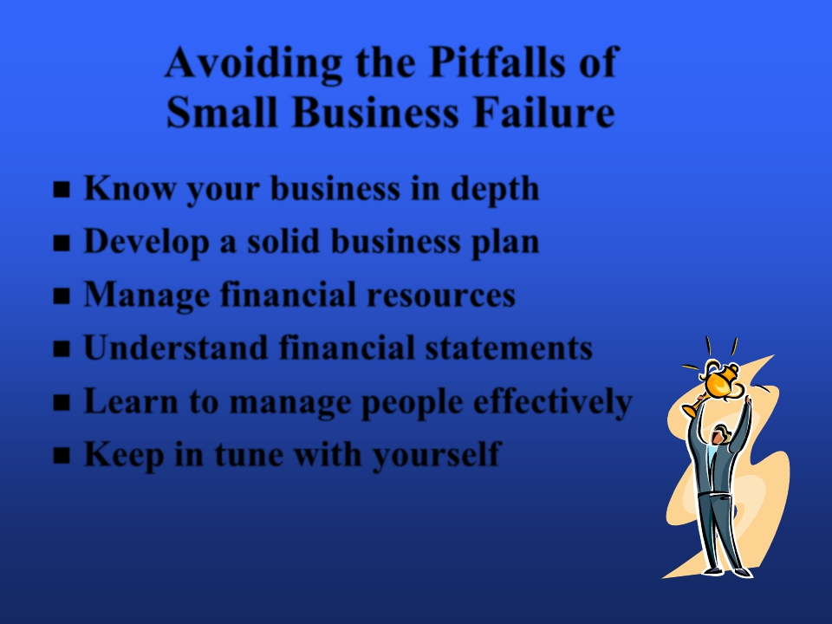
Avoiding the Pitfalls of
Small Business Failure
Know your business in depth
■
■ Develop a solid business plan
■ Manage financial resources
■ Understand financial statements
■ Learn to manage people effectively
■ Keep in tune with yourself
Chapter1: Entrepreneurship
2

Slide 34
How does one start a new venture?
Questions that keep a new venture focused on its customers …
Who is your customer?
How will you reach key customer market segments?
What determines customer choices to buy or not buy your product/service?
Why is your product/service a compelling choice for the customer?
How will you price your product/service for the customer?
How much does it cost to make and deliver your product/service?
How much does it cost to attract a customer?
How much does it cost to support and retain a customer?

Slide 35
How does one start a new venture?
Life cycle of entrepreneurial firms
Birth stage
Breakthrough stage
Maturity stage
Each stage poses different managerial challenges and requires different managerial competencies.

Slide 36
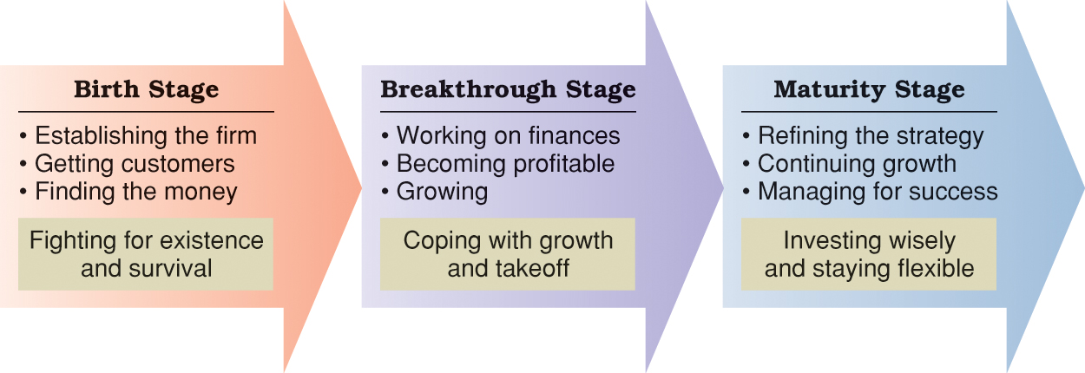
Stages in the life cycle of an entrepreneurial firm.

Slide 37
ASSIGNMENT : “ CASE STUDY”
My New Restaurant Has Rave Reviews, But Business Is Slowing Down Dramatically. Why?
We want to know what we can try to drive people into our restaurant and keep them coming back. What should we do?

